Slide 1
Project 1: an analysis of data science salaries

Slide 2
Company goals: Hiring a data scientist, what should we pay?
The CEO is seeking to hire a data scientist with leadership potential.
The data science job market is highly competitive, with salary expectations varying by location, experience level, and work flexibility.
Remote work is permitted, and offshore hiring is under consideration as a cost saving option.

Slide 3
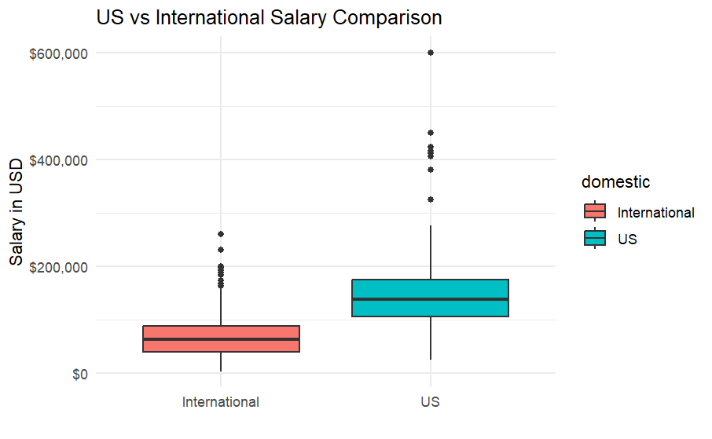
US vs International Salary Comparison
U.S.-based salaries average ~$80,000 higher than international salaries
Offshore hiring can significantly reduce costs
Potential trade-offs include time zones, and collaboration
US average: $142,697
International average: $70,570

Slide 4
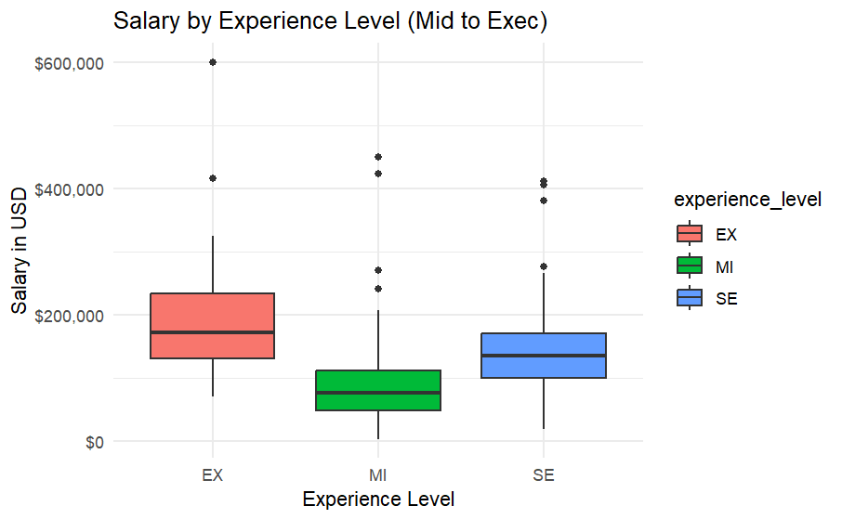
Salary by experience level
Mid-level average salary: ~$88,000
Senior-level average salary: ~$139,000
Executive-level average salary: ~$193,000
A mid-level professional may grow into a leadership role, aligning with the CEO’s long-term vision
If hiring a leadership position outright, a significantly higher salary should be expected

Slide 5
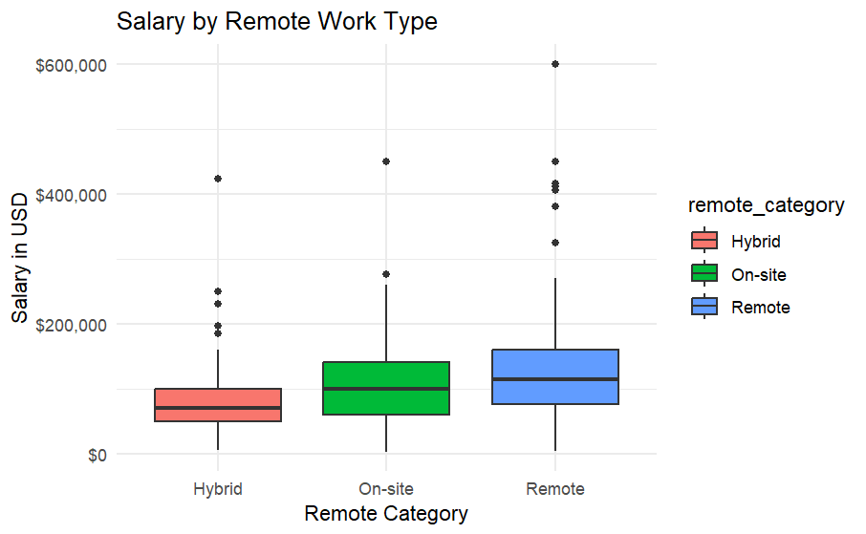
Remote Work and salary expectations
Fully remote average salary: ~$122,000
Hybrid: ~$106,000 |
On-site: ~$81,000
Remote roles tend to pay more — possibly reflecting higher experience levels or market demand
Offering remote flexibility may help attract stronger candidates, but comes at a higher cost

Slide 6
Recommended salaries based on hiring priorities
My analysis shows that U.S.-based candidates are nearly twice as expensive as international ones, but also more likely to bring strong leadership potential. Remote roles tend to pay more on average, likely because they attract more experienced professionals. If leadership is the top priority, we should plan to offer ~$120K–$170K for a U.S.-based candidate. If cost is the main concern, an offshore remote hire could work at around ~$70K–$90K.

